Slide 1
City Grid Simulator
By OGEN MALEK, Roy Goldstein, Nir Tsabar and Oren Shmuel

Slide 2
Agenda
Project Goals
System modules
Current project status -
Gateways choosing and Tree algorithms.
Running workflow.
Few Graphs.
A look on the future.

Slide 3
Project Goals
Simulate a wireless network containing thousands of units.
Measure the network performance.
Easy to use.
Fast simulation.
Maximize flexibility – the user can change almost everything!
Easy to develop and measure new algorithms.
Ability to analyze simulations.

Slide 4
System Modules
Map
Grid Generation
- Placing RSUs randomly and make sure it’s a strongly connected components graph.
Set Gateways locations
Build Trees
Simulator
Events
Mac Layer + Link Layer
Application Layer
Logging System
Graph Generation using Excel

Slide 5
Choosing gateways algorithms

Slide 6
Choose gateways Randomly
Choose the gateways randomly.

Slide 7
Choose gateways by Connection Quality
Stage 1:
Divide the graph to Strongly Connected Components (SCC) based on link quality.
Stage 2:
In each SCC pick the RSUs with most neighbors (with quality of the SCC).

Slide 8
Choose gateways by Shortest Links
Stage 1:
Divide the graph to Strongly Connected Components (SCC)
based on link length using Binary Search to find the best SCCs division.
Stage 2:
In each SCC pick the RSUs with most neighbors (with quality of the SCC).

Slide 9
Choose Gateways by Topology
Stage 1:
Divide the RSUs to regions with equal number of RSUs in each region.
The division is done by ordering the RSUs according to their location on the axis with the biggest delta between the two ends.
Stage 2:
In each region set the gateway in the middle of the other axis.

Slide 10
Building the trees

Slide 11
Shortest radio distance
Find the shortest radio distance from each node to a gateway.
Using Dijkstra from each gateway – find the radio distance to each RSU.

Slide 12
Shortest path trees
Find the shortest path from each node to a gateway (Ignoring link quality).
Using Dijkstra from each gateway – find the shortest paths to each RSU.

Slide 13
Link Quality
Find the best link quality paths from each node to a gateway.
each link is assigned a weight which is 1/LinkQuality.

Slide 14
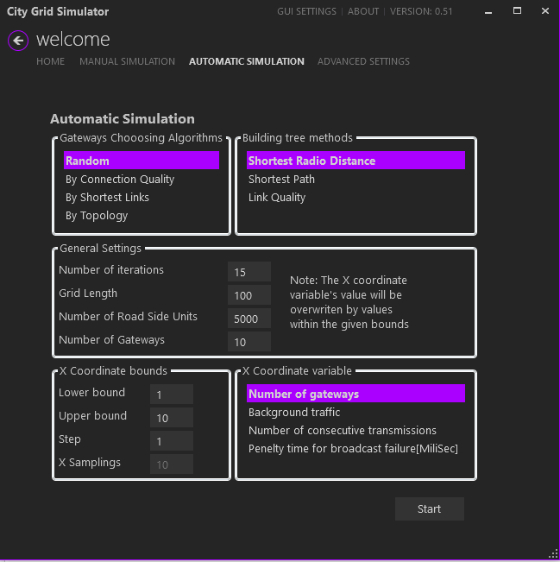
The automatic simulation window
In this window we define and run the simulation, in the end of the simulation an Excel with all the raw data and graphs will be generated.
Choose the relevant algorithms to compare.
Choose the general simulation settings.
Choose the X coordinate variable.

Slide 15
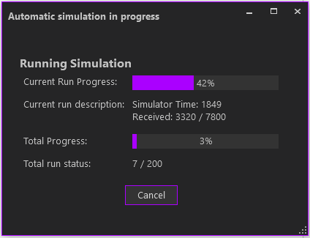
The progress window
Updates about the simulation progress.

Slide 16
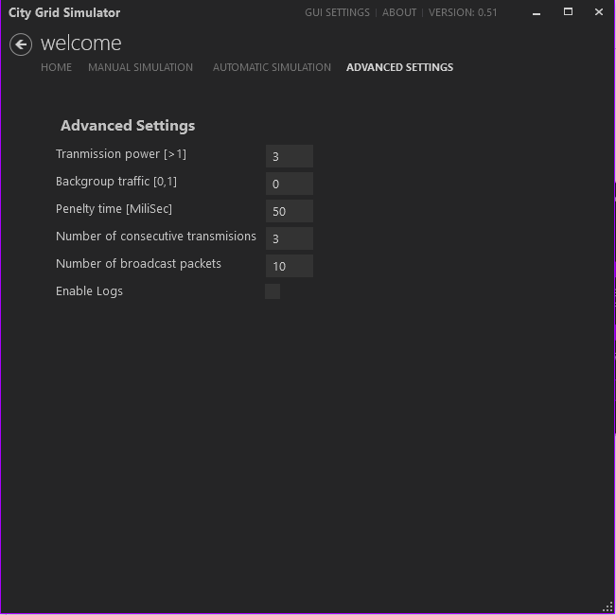
Advanced parameters settings
Settings for the advanced parameters of the simulation.

Slide 17
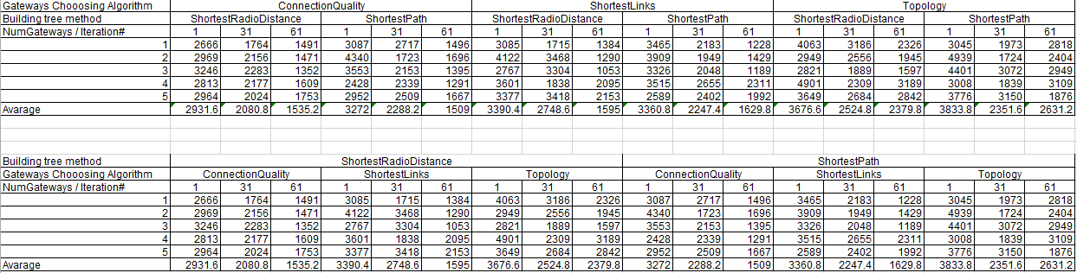
The excel raw data

Slide 18
Graphs.. More Graphs!

Slide 19
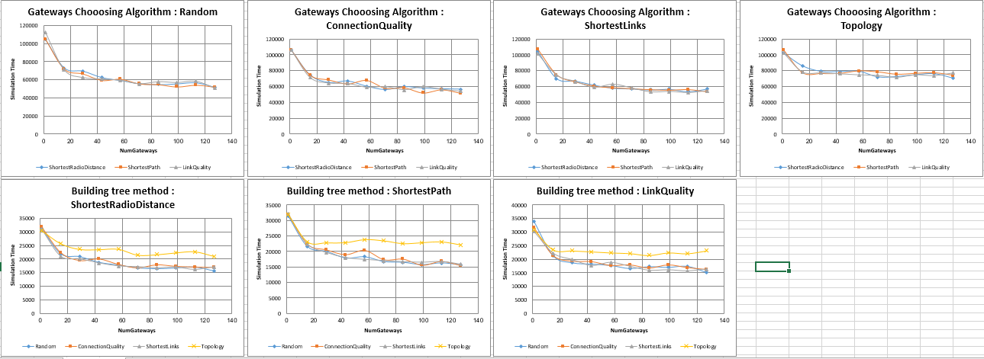
Graphs – Simulation output

Slide 20
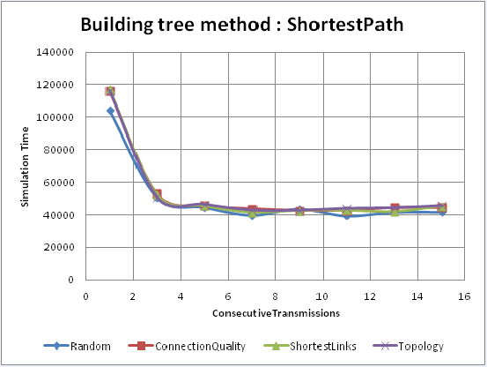
Graphs – Consecutive transmissions
A graph that compares the Gateways choosing algorithms.
The X axis is represented by number of consecutive transmissions.
The tree was built by Shortest Path tree building algorithm.
Conclusion: The price of additional transmissions is low so we should use ~5 consecutive transmissions.
Grid Length: 50
Number of RSUs: 700
Background Traffic: 0.3 (Same results for background traffic 0)
Penalty Time: 6000
Number of gateways: 10

Slide 21
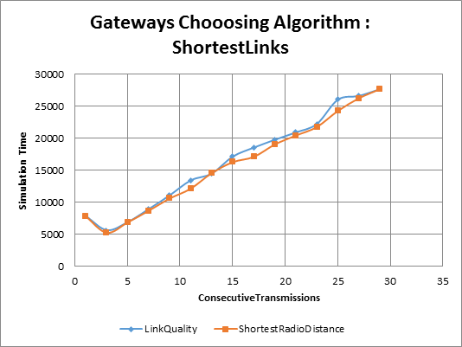
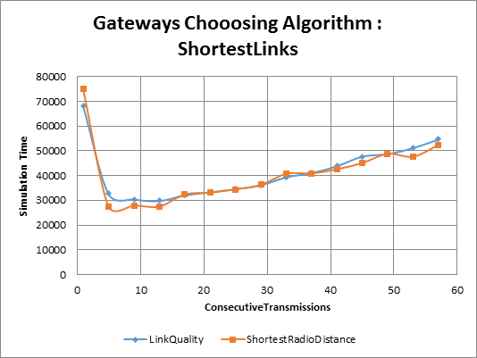
Graphs – Consecutive transmissions
A graph that compares the tree building algorithms.
The X axis is represented by number of consecutive transmissions.
The gateways were chosen by the Shortest links algorithm.
Conclusion: for small penalty there is an optimum at 3~ consecutive transmissions, while we lose a lot of performance for higher consecutive transmissions number.
Grid Length: 20
Number of RSUs: 200
Background Traffic: 0.3 (Same results for background traffic 0)
Penalty Time: 500(Upper graph) \ 6000(Lower graph)
Number of gateways: 10

Slide 22
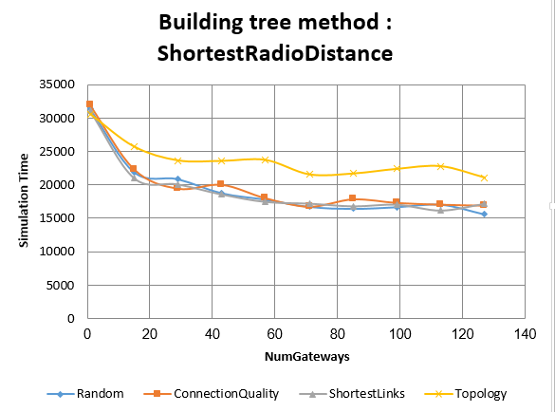
Graphs – Number of gateways
A graph that compares the Gateways choosing algorithms.
The X axis is represented by number of gateways.
The tree was built by Shortest radio distance tree building algorithm.
Conclusion: Topology algorithm has lower performance than the other algorithms.
Grid Length: 130
Number of RSUs: 7000
Background Traffic: 0.3 (Same results for background traffic 0)
Penalty Time: 6000
Number of consecutive transmissions: 5

Slide 23
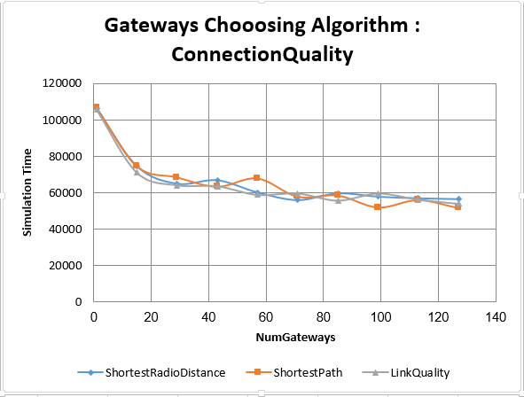
Graphs – Number of gateways
A graph that compares the Tree building algorithms.
The X axis is represented by number of gateways.
The gateways were chosen according to connection quality algorithm.
Conclusion: As number of gateways increases, we get better performance for all the algorithms.
All the algorithms have the same performance.
Grid Length: 130
Number of RSUs: 7000
Background Traffic: 0.3 (Same results for background traffic 0)
Penalty Time: 6000
Number of consecutive transmissions: 5

Slide 24
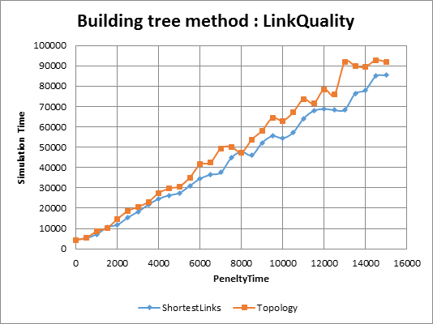
Graphs – Penalty time
A graph that compares the gateways choosing algorithms.
The X axis is represented by the penalty time.
The tree was build according to link quality algorithm.
Conclusion: The Shortest Links algorithm performed better than the Topology algorithm.
Larger penalty time increases the duration of the simulation.
Grid Length: 20
Number of RSUs: 200
Background Traffic: 0.3
Penalty Time: 6000
Number of consecutive transmissions: 3

Slide 25
Look to the future
More Gateways choosing algorithms.
Add additional building tree algorithm.
We can achieve even better performance by Parallelize the simulation.
Adding control over more variables?
Let’s define the project objectives.

